Slide 1
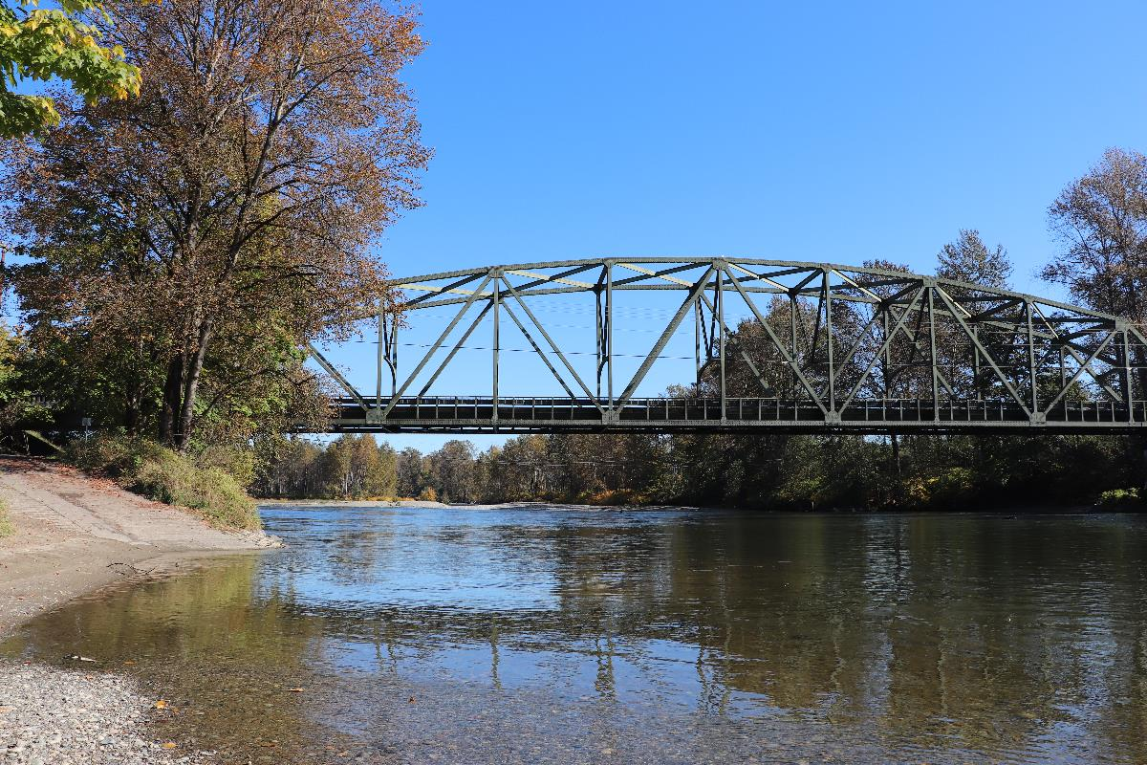

Davis Annexation Initial Meeting
City Council
September 9, 2025, 7:00 PM

Slide 2
Overview of Annexation Process
First Step:
Initial Meeting with City Council
Interlocal Agreement
Development Agreement
60% Signatures

Slide 3
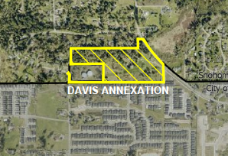
Annexation Area

Slide 4
Requested Action
Move to direct staff to prepare and return for the City Council’s consideration a resolution accepting the annexation boundary of the ten percent (10%) annexation petition for property located in an unincorporated area north of city limits, and to require the assumption of existing indebtedness of the City by the area to be annexed; to authorize the circulation of a petition for annexation of the property consistent with this motion; and to direct the City Clerk to record this action in the official minutes.
Move to direct staff to commence review process for pre-annexation zoning for the subject properties.
Move to direct staff to coordinate with the applicants to meet with all affected city departments and Snohomish County Regional Fire and Rescue at a Pre-Application meeting to discuss conceptual layout of the site, extension of utilities, the transportation network, etc.
Move to direct staff to coordinate with the applicants to prepare and submit a Pre-Annexation Development Agreement.
Move to direct staff to coordinate with Snohomish County to prepare a site specific annexation interlocal agreement covering the transfer of and/or maintenance of utilities, infrastructure, permitting, etc.

Slide 5

Questions?
Amy Bright
Planner
abright@monroewa.gov

