Slide 1


STATE OF THE CITY 2017

Slide 2
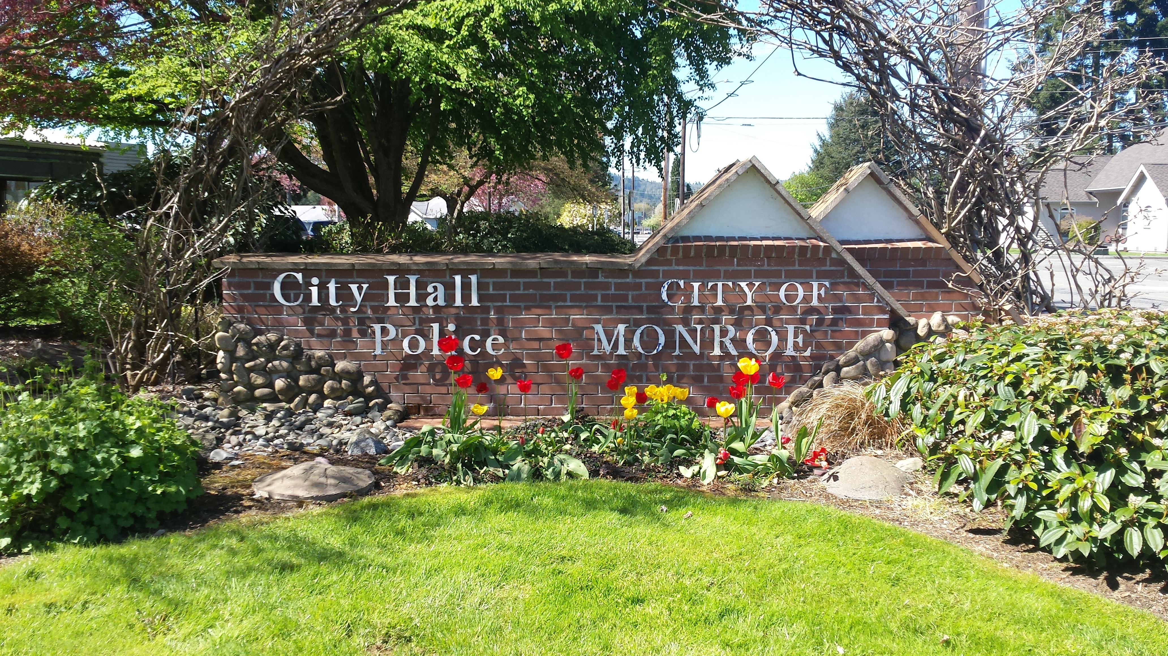


Slide 3
ADMINISTRATION
CITY ADMINISTRATOR
Monitoring Revenues and Expenditures and managing the annual budget
Managing the day-to-day operation of all City services
Ensures Mayor and City Council are fully and adequately informed on all issues
HUMAN RESOURCES
Manages the recruitment process for all vacant positions
Advises Departments on personnel concerns
Manages and negotiates labor and technology contracts
Notes:
City Administrator reports directly to me and is responsible, under my direction, for the day-to-day management of City government.
Makes sure the City remains in sound financial condition
Provides research and information on issues facing the City and issues under consideration by me and the Council
Human Resources and the City Clerk office provides essential services to the rest of city government, (such as union contracts, hiring, maintaining and updating the Monroe Municipal Code, etc…), both in terms of personnel issues and the management of all City records.

Slide 4
ADMINISTRATION
CITY CLERK
Manages all City Hall Records
Ensures compliance with Open Public Meetings law
Ensures publication of City Council meeting agenda’s
Produces minutes of all City Council meetings
Ensures proper codification of all ordinances
Notes:
Public Disclosure
2016 – 276
YTD 2017 - 66

Slide 5
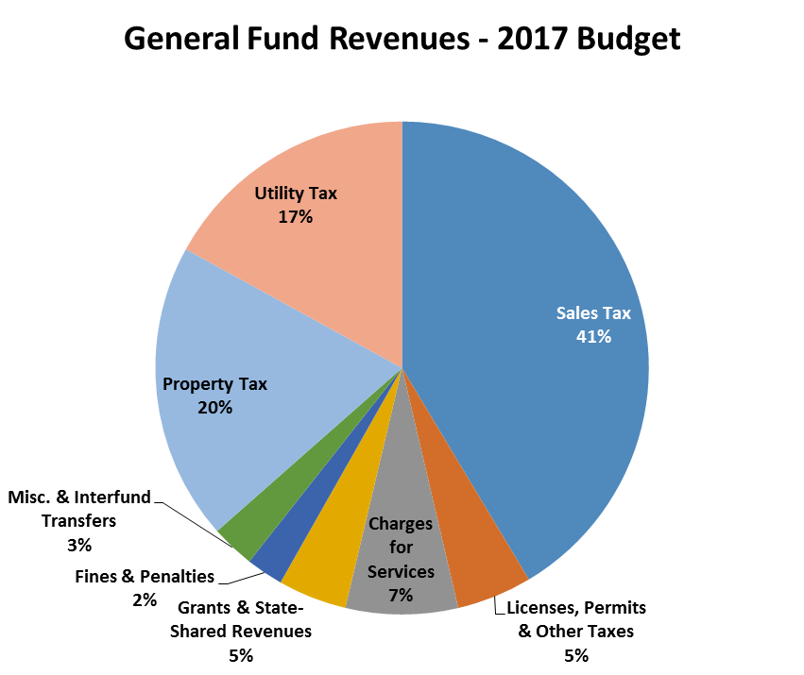
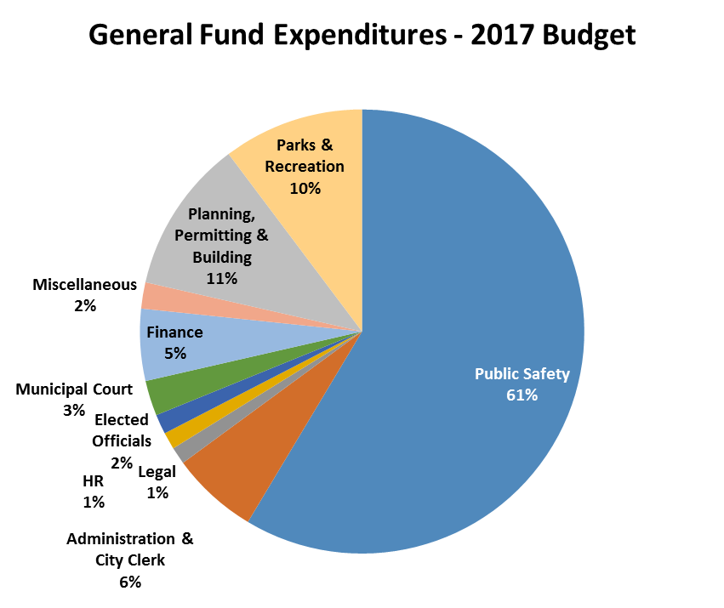
FINANCE
Notes:
As indicated by the Pie Chart on the right, Public Safety remains one of the top priorities for the City, representing almost 2/3 of our general operating budget.
On the left chart, you see sales taxes are our largest general operations revenue source. As you’ll see on the next slide, sales taxes continue to grow as our city grows and the economy improves.
The more we can shop local and/or have our internet sales delivered here within the City, the more we help with funding our Public Safety and other City services.
Prudent fiscal stewardship suggests maintaining appropriate reserves in our budget. The 2017 Budget fully funds our reserves to our target levels. Part of the reason we were able to do this was that we
Saved $455,000 in 2016, which rolled over into 2017
2016 revenues came in $214,000 more than estimated
2016 expenditures came in $267,000 less than estimated
Contingency is fully funded
Revenues are fully funded

Slide 6
YEAR-TO-DATE COMPARISONS
 | 2013 Total | 2014 Total | 2015 Total | 2016 Total
Sales Taxes | $3,444,040 | $3,617,210 | $4,064,056 | $4,503,844 (23.53% inc since 2013)
Real Estate Excise Tax | $452,169 | $491,647 | $741,907 | $942,493 (108.44% inc since 2013)
Building Permit Revenues | $413,712 | $281,895 | $434,635 | $1,025,067 (147.77% inc since 2013)
Planning Revenue | $124,290 | $115,202 | $125,225 | $158,171 (27.25% inc since 2013)
Notes:
Again, sales taxes continue to grow as our City grows and the economy improves.
2016 sales taxes have increased 23.53% since 2013
2017 sales taxes through April are 9.66% ahead of budget
City growth also positively affects our Building Permit and Planning revenues, along with our Real Estate Excise Tax receipts, which can be used for street and parks projects.
2016 REET, which is used to fund Capital Improvements (roads, parks, City buildings, sidewalks, etc…) has increased 108.44% since 2013
2016 Building Permits have increased 147.77% since 2013
And 2016 Planning Revenue has increased 27.25% since 2013

Slide 7
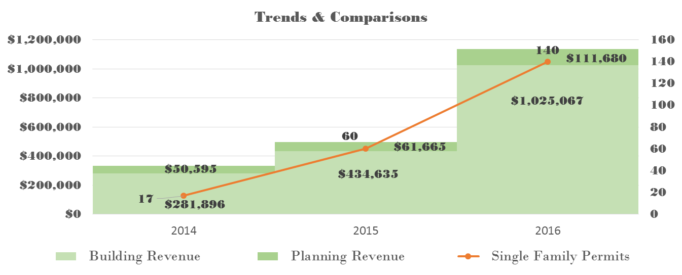
COMMUNITY DEVELOPMENT
Planning, Building, and Permitting
Building
Inspections 1,548 1,713 2,546
Notes:
Building Department revenue (from previous years) has increased: 54% in 2015 and 136% in 2016.
Planning Department revenue (from previous years) has increased: 21% in 2015 and 81% in 2016.
Single-family Permits alone (from previous years) have increased by 253% in 2015 and 133% in 2016.
Building inspections reached 2,546 inspections in 2016, up 49% from the previous year
2017 Projections based on 1st qtr data
Building Revenue $1,481,112 up 44%
Planning Revenue $123,712 up 11%
Single Family Permits: 152 up 8%

Slide 8
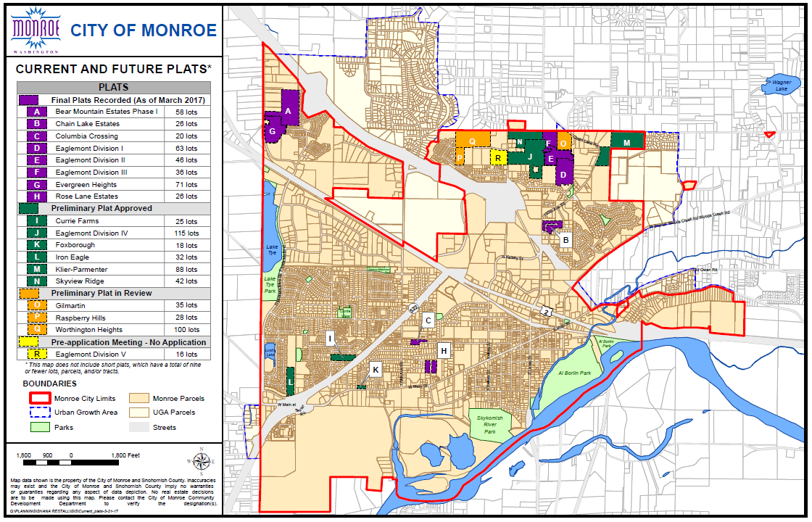
Notes:
I Realize this is a busy slide, but tells an important story of growth in Monroe.
2016 Plats/Multifamily
Applications received for 294 new SFR lots
Approval of 200 new SRF lots
Lake Apartments/122 units/In Review
Currently, approximately 800 residential units in the pipeline. All the Lettered Areas are single family plats that are in some stage of the permitting process. Monroe is getting new developments in larger lots and infill near downtown.
2016 Commercial Projects of Note:
Park Place Middle School/128,000 sq ft modernization/under construction
Rudeen Building (Frylands Ind.)/24,822 sq ft building/construction complete
Carl’s Jr/3,000 sq ft building/complete

Slide 9
MONROE POLICE DEPARTMENT
2016 ACCOMPLISHMENTS
Contracted with Domestic Violence Services of Snohomish County to provide a part-time DV Advocate on staff at the police department, assisting victims of domestic violence.
Successful Special Olympics fundraising campaign which earned the department a “Bronze” level award in the Circle of Honor – this fundraising included a new community event – Wings N Wheels at First Air Field.
Increased Social Media presence – Facebook, Twitter, and Nextdoor.
Completed 5 year Strategic Plan for implementation in 2017.
Notes:
In 2016, the Monroe Police Department responded to 220 reported incidents of domestic violence. This was also the first year our City has contracted with Domestic Violence Services of Snohomish County to provide a part-time DV Advocate. The Advocate is on staff two days a week, reaching out to victims of domestic violence, providing confidential services, emergency shelter, legal advocacy, support groups and education.
The police department has supported efforts to raise money for Snohomish County Special Olympians for many years. This year they were recognized for their 2016 fund raising efforts, earning a “Bronze” level award in the Circle of Honor. This included a new Community event – “Wings N Wheels” at First Air Field.
The department has also increased their Social Media presence via Facebook, Twitter and Nextdoor. These sites are used to inform, interact and share “happenings” with our community.
The department also completed a 5 year Strategic Plan. Officers and other members of the department met with businesses, community leaders and the public to put together this plan that will serve to guide the department over the next five years.

Slide 10
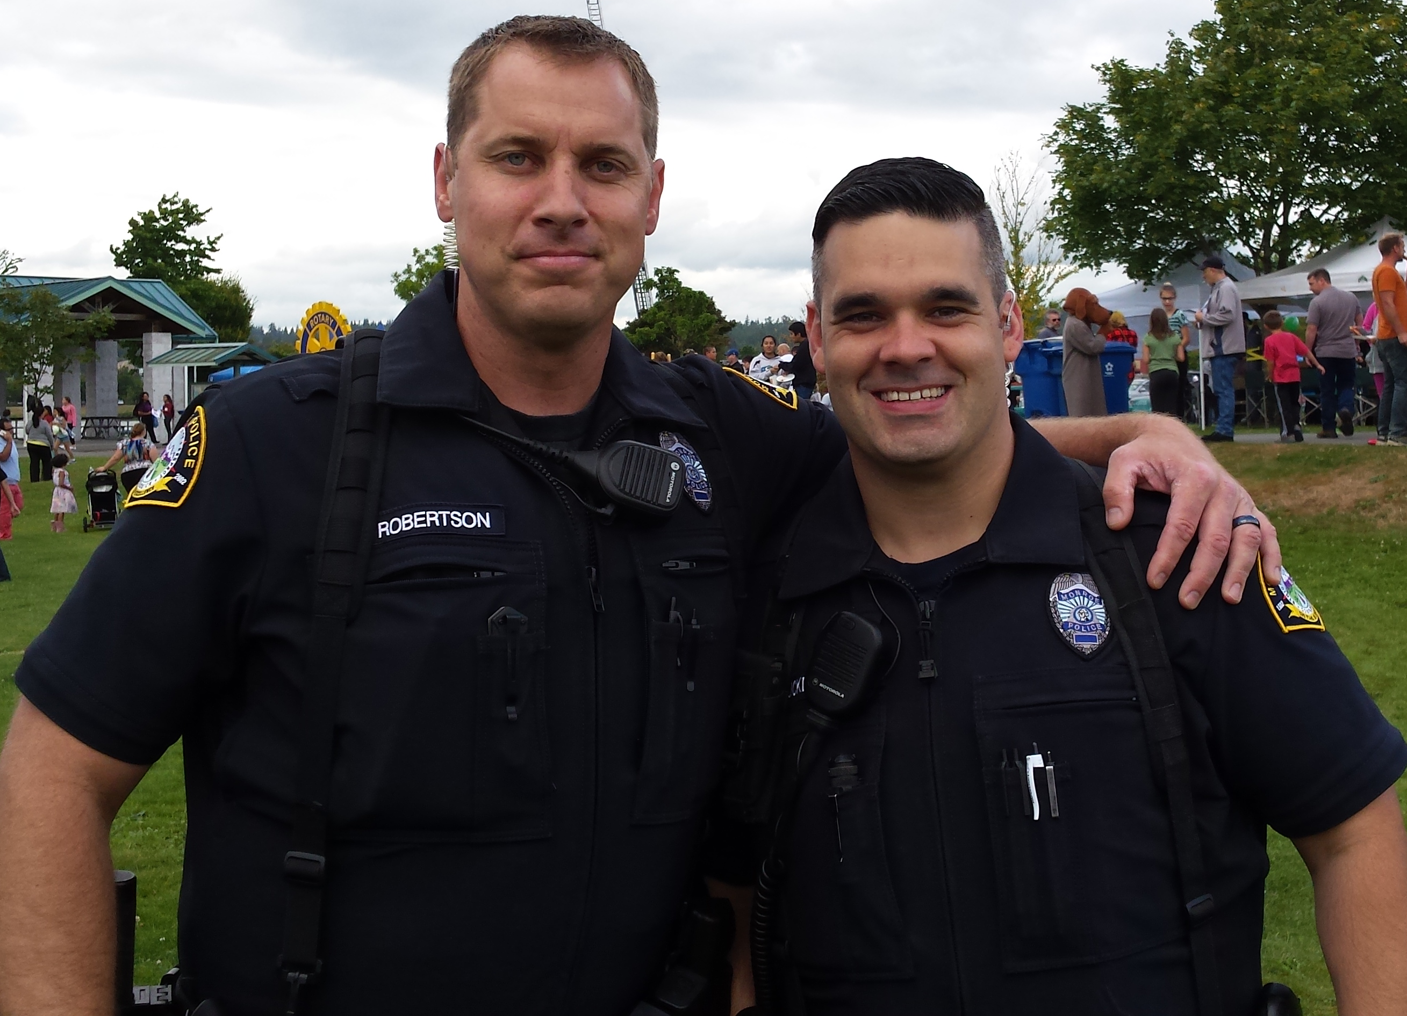
MONROE POLICE DEPARTMENT
New for 2017
Introduction of Embedded Social Worker – Elisa Delgado
Purchase of off-road vehicle to allow access to wooded areas of parks and private property where encampments are found
Implementation of Strategic Plan
  Combating Crime to Enhance Safety and Quality of Life
  Promoting Community Involvement
  Providing Openness and Transparency
  Supporting Professional Development
Look for “Coffee with a Cop” program; contact the police department if interested in hosting.
Notes:
Looking forward to a new program that began last month bringing an embedded social worker to our City. Elisa Delgado will be working in the City part-time, riding with officers as they interact with those that may be homeless and in need of help.
You may have seen a new off-road vehicle being used in and around the parks and private property where encampments are found. This vehicle will assist the officers to access areas that can’t be reached with a regular vehicle.
2017, the department will be implementing their strategic plan with the primary goals of:
Combating Crime to Enhance Safety and Quality of Life
Promoting Community Involvement
Providing Openness and Transparency
Supporting Professional Development
The department has already planned their first “Coffee with a Cop” meeting with the public on May 16th at 10:00 am at Sahara Pizza. Additional ones will be planned throughout the year, giving you a chance to meet with our officers, discuss issues and learn more about each other.

Slide 11
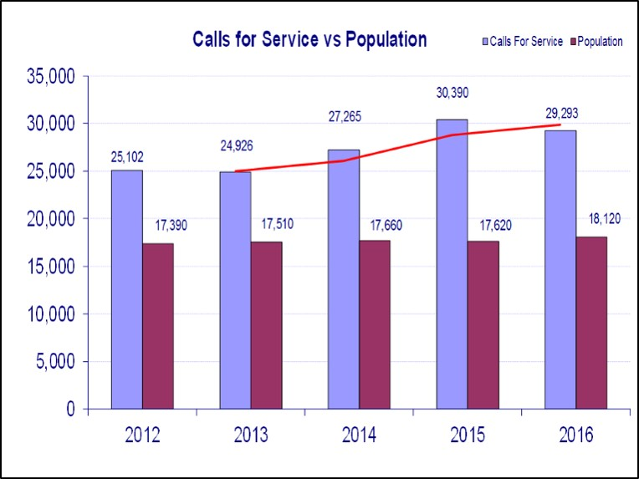
MONROE POLICE DEPARTMENT
Notes:
Calls for service include reactive and proactive officer responses.
Reactive calls for service are those that come to the officer from the 911 dispatch center.
Proactive calls for service are officer initiated such as a traffic stop for speeding or contacting a suspicious circumstance that they may see as they patrol our City.
We are seeing a slow but steady rise in our Calls for Service, this trend is expected to continue as we see growth in our City and surrounding areas.

Slide 12
PUBLIC WORKS
Provides infrastructures and services essential to the welfare and acceptable quality of life for Monroe’s citizens.
Infrastructure operations and maintenance
Overseeing new infrastructure development
Ensuring safety of the water supply
Protecting public health and the environment
Notes:
Operate and Maintain
102 miles of streets
176 miles of water mains
6413 water meters
67 miles of sewer mains
1049 sanitary sewer manholes
53 miles of stormwater management facilities
2572 stormwater catch basins and manholes
New Infrastructure 2016
1.74 miles of streets
1.61 miles of water mains
1.46 miles of sewer mains
2.78 miles of stormwater mains
2016: Received $3,256,991.24 in grant reimbursement

Slide 13
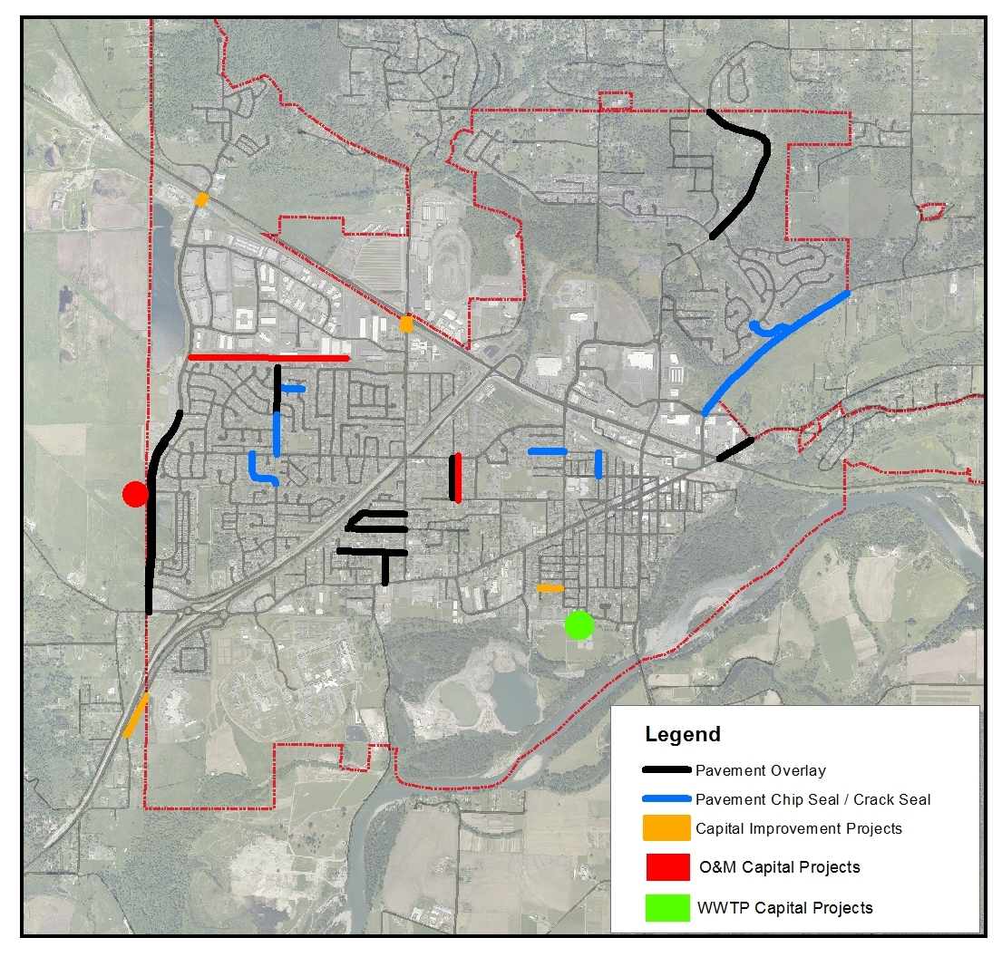
PROJECTS
Notes:
Projects underway
Construction
Tester Road Watermain Upgrade
Pedestrian At Grade Railroad crossings – 179th & Fryelands Blvd
Fairfield Park Entrance
Powell Street Sewer Upgrade
Roadway Rehabilitation
Chain Lake Rd
Fryelands Blvd
Old Owen Rd
Woods Creek Rd
Local Streets Chip Sealing
Design
Chain Lake Road Shared Path
Smith & Park Utility Upgrades
Dickinson Street Utilities
Airfield Watermain Upgrade
Lighting has been installed at Woods Creek and Lake Tye. Accent lighting is up in the downtown area as well.

Slide 14
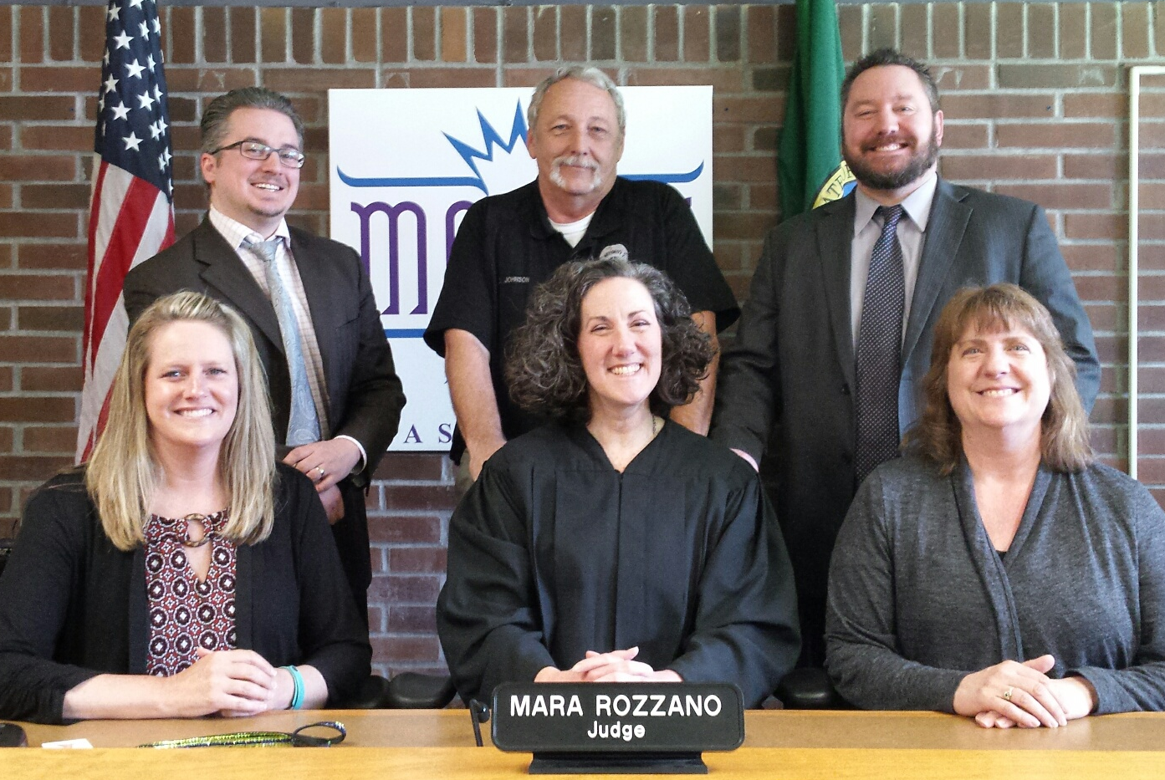
MUNICIPAL COURT
Court “By The Numbers” 2016
Court session are on Tuesday mornings and all day Wednesdays; jury trails are on the 4th Friday.
In 2016 the court processed 3277 citations from the Monroe Police Department: 2721 civil infractions, 118 criminal traffic misdemeanors, 382 non traffic misdemeanors, and 56 parking violations.
Judge Rozzano signed 27 search warrants for law enforcement.
In the first quarter of 2017 – 193 cases were heard via video court
Court staff currently monitors 350 post conviction cases for sentence compliance yearly.
Notes:
By creating the local court, we now have all three branches of government locally represented.
Benefits to our community include flexibility in response to local issues, less wait time for officers in court. And the ability to implement innovative programs because it no longer required a county wide consensus.
Programs and policies at the District Court must be agreed upon by all the Dist Crt judges, not just those in our area.

Slide 15
MUNICIPAL COURT
Court - Looking Ahead Into 2017
Continue to utilize alternative sentencing programs with the goal of reintegrating individuals back into productive members of society:
  Community service in lieu of jail time or towards legal financial obligations
  GED completion for credit towards legal financial obligations
Establish a volunteer run veteran’s court
Investigate other community based court programs to encourage civic growth and reduce repeat offenders
Notes:
(Veteran’s Court) In response to the unacceptable number of our veterans who are among the homeless and addicted in our community, this program combines volunteer mentors with defendants who have served in the armed forces to assist with getting to treatment through the VA for mental health or addiction related to PTSD.
<<Below is provided in case you get a question>>
Other potential community based courts we are considering are:
STUDENT COURT: Students, with the help of a mentor/coach act as the judge and advocates in judging student related driving offenses. This program has been shown to foster accountability and leadershi[ among the youth involved.
Judges In The Classroom/Street Law Program: Puts judge in the courtroom to provide civics lessons in a more involved and interactive program. Lessons range from DUI laws to Consumer Law.
Driving While Suspended Diversion/Relicensing Program: The goal of this program is to get these minor offenders relicensed and insured so they are accountable. Court personnel work with the Department of Licensing to provide these offenders with the tools to get their licenses back.

Slide 16
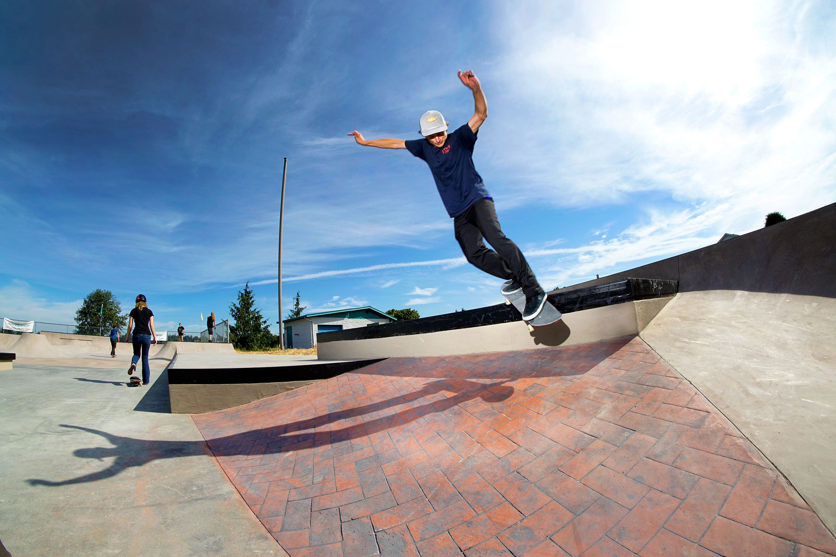
PARKS AND RECREATION

Slide 17
PARKS AND RECREATION
2016 ACCOMPLISHMENTS
Parks and Trails Maintenance
Community Events that Promote Tourism and their Economic Impact
Volunteer Programs
Projects, Grants & Partnerships
Notes:
Maintained 240 acres of parks;10 miles of trails
Supported events bringing over 600,000 people and approximately $26 million in economic revenues to our community
Volunteer programs - 1,000+ service hours; donations valued at $10,000+
Skate park renovation completed with state grant funding, county grants awarded for new event fencing and tourism-branded street-pole banners, purchased new portable performance stage, supported American Legion’s gift of beautiful Veteran’s Memorial @ Lake Tye Park, new downtown art sculpture – Wagner Swifts.

Slide 18
PARKS AND RECREATION
NEW FOR 2017
Parks and Trails Maintenance
Community Events that Promote Tourism and their Economic Impact
Volunteer Programs
Projects, Grants & Partnerships
Notes:
Continue to maintain and improve our 200 plus acres of parks, trails, and streetscapes, with addition of new roundabout @ Main Street and SR 522.
In 2017, tourism and events will continue to grow in our parks, the fairgrounds, Meadow Wood Equestrian Center, and at the newly upgraded Lake Tye Skate Park, funded in part through a state grant.
Initiated Adopt-A-Park Agreement with Monroe Boys & Girls Club for Sky River Park
Playground renovation – Lake Tye Park – scheduled to be completed by the end of this month
Realignment of Entry to Fairfield Park in partnership with Snohomish County Parks - scheduled to begin this summer
Master planning of Cadman Pit site and Lake Tye Park – currently advertising for master planning services
Design synthetic turf field upgrade - Lake Tye Park – lobbying for state funding for construction.
We are also pleased that our request for $1 million to convert the Lake Tye fields to synthetic turf is making progress. There is $800,000 in the House Capital budget for the Lake Tye fields. The Capital budget has not been finally adopted but we are hopeful that these funds will remain in the final budget. We are very appreciative of the support we have received on this issue from Sen. Pearson and Reps. Kristiansen and Koster.
Downtown Furniture replacement – new furniture ordered; will be installed this year
City grant funding for Downtown Events
Applied for Snohomish County Small Capital Projects Grant in partnership with Monroe Boys & Girls Club for Exercise Stations at Sky River Park

Slide 19
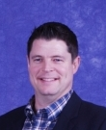

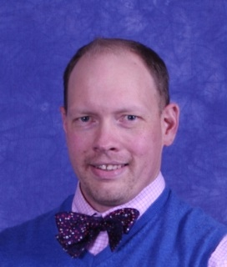
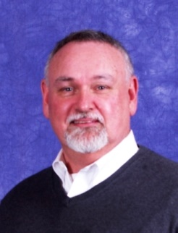
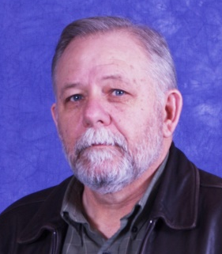
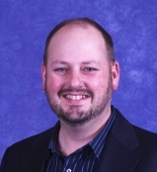
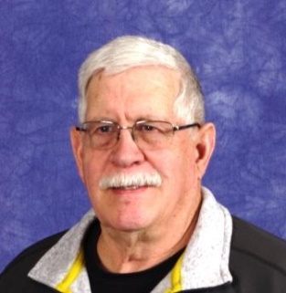
CITY COUNCIL
Contact: councilmembers@monroewa.gov
Kevin Hanford
Position 1
Patsy Cudaback
Position 2
Jeff Rasmussen
Position 3
Jim Kamp
Position 4
Ed Davis
Position 5
Jason Gamble
Position 6
Kirk Scarboro
Position 7

Slide 20
