Slide 1
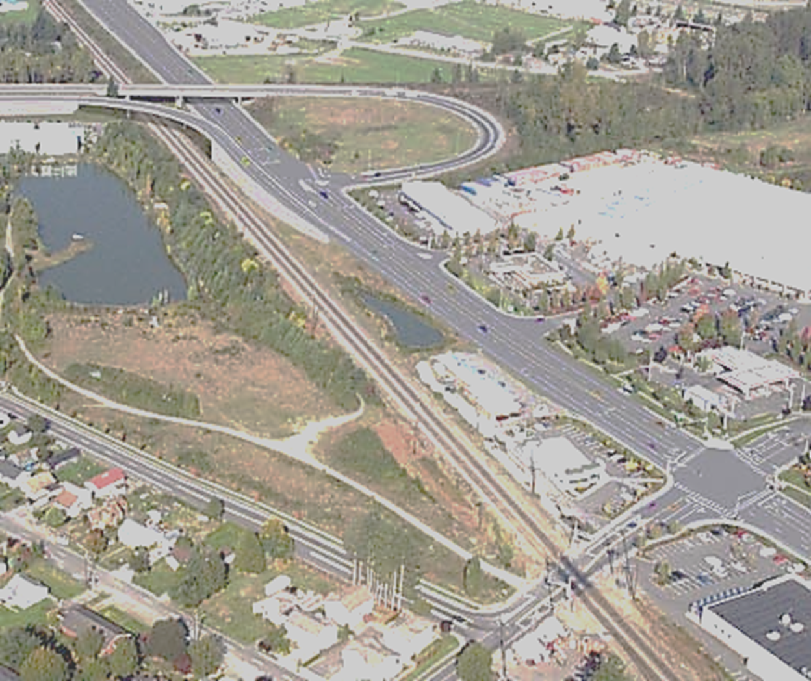


MONROE 360

Slide 2
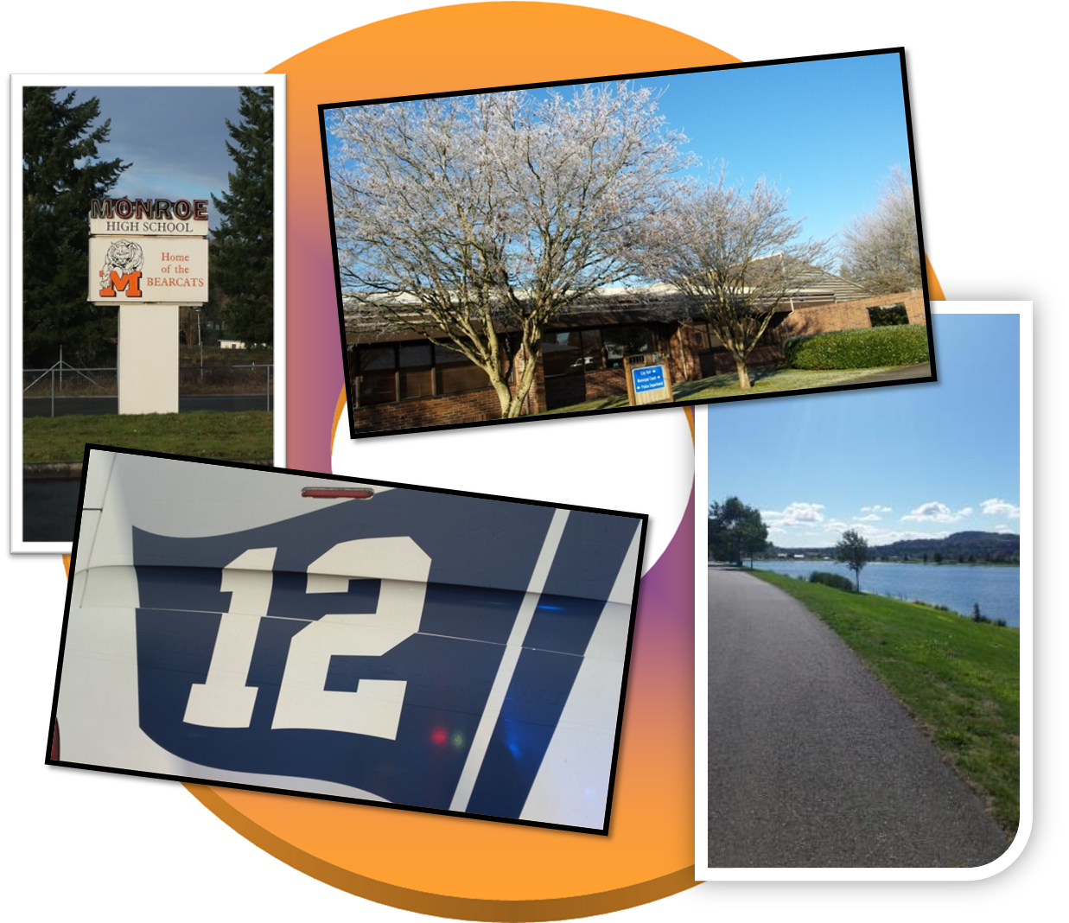

Slide 3
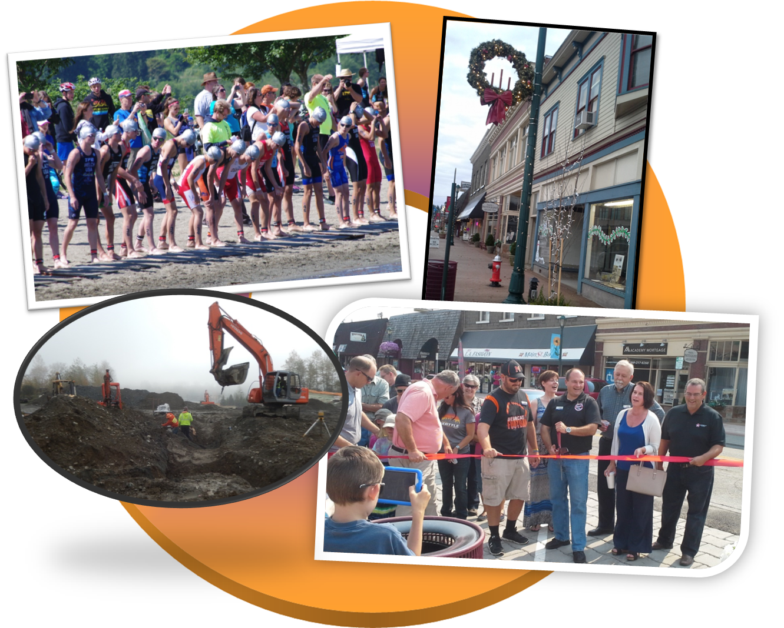

Slide 4
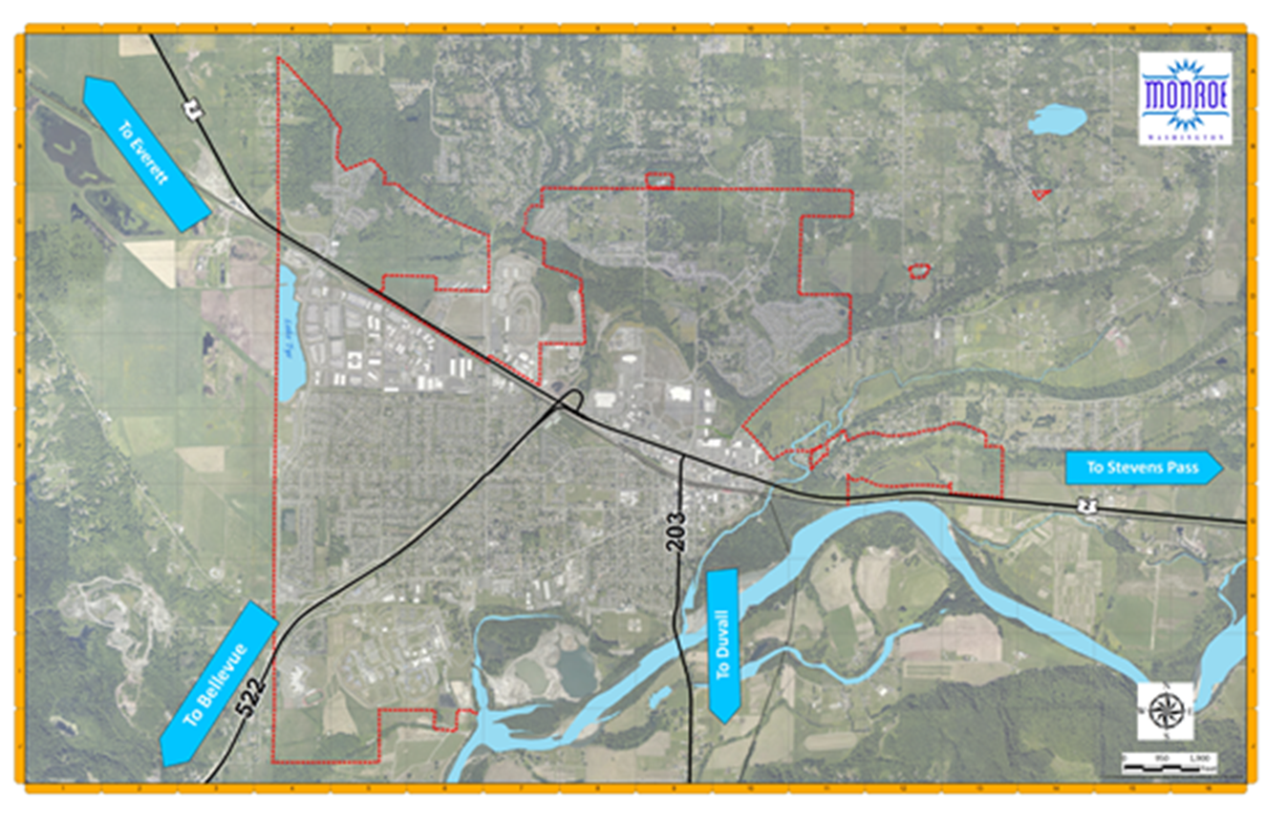

Slide 5

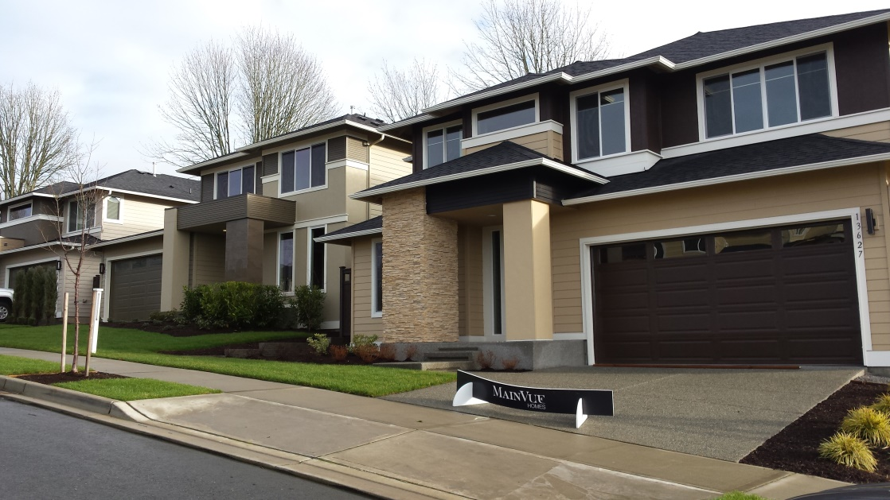
Community Development
Monroe Is Growing

Slide 6

Trends 2014-2015
 | 2014 | 2015 | % Change
Single Family Permits (Issued) | 17 | 60 | +253%
Building Permit Revenue | $180,017 | $311,092 | +72.81%
Planning Revenue | $50,595 | $61,665 | +21.88%
Building Division Inspections | 1,548 | 1,713 | +10.7%

Slide 7

Year-to-Date Comparisons
 | 2015 3/31/2015 | 2016 3/31/2016 | % Change
Building Permit Revenues | $82,947 | $85,216 | $2,269 +2.74%
Planning Fee Revenues | $9,090 | $7,625 | $1,465 -16.12%
New House Permits | 21 | 19 | 2 -9.5%
Multi-Family Permits | 13 | 4 | 9 -69.2%
Building Division Inspections | 398 | 420 | 22 +5.5%

Slide 8


Single Family Development
Lots Created (Last 18 months)
165+
Lots Currently in Permitting
Approx. 372
Subdivision Proposals Under Discussion
(Application Not Yet Submitted)
Approx. 300

Slide 9
PROJECTS
2015 (Under construction or completed)
Tractor Supply (22,000 square feet)
Canyon Creek Cabinet (25,488 square foot addition)
Monroe Family Village (Housing Hope) - 47 units
2016 (Starting construction or in permitting)
Park Place Middle School Modernization - Replace existing school with new 128,000 sq. ft. school (phased over 3 years)
Carl’s Junior (beginning construction)

Slide 10
2016 Initiatives
Permit Process Improvements
Stakeholder Meeting (What we heard)
Eliminate Excessive Code Mandated Timelines
Clarify Application Forms
Consider Technology Improvements
(Allow Customers to do Permitting on-line 24/7)
Downtown Main Street Program
Consultant evaluating how to create a successful Main Street Program.

Slide 11

Finance
General Fund
Saved $454,968 in 2015, rolled over into 2016
Revenues came in $214,000 more than estimated
Expenditures came in $267,000 less than estimated
2016 Sales Tax Revenues are even with estimates
Estimates for sales tax for 2016 revenues to be 7% more than 2015 revenues

Slide 12
A 5 year forecast of the City’s General Fund is used to project the “bow-wave” of our financial decisions in future years.

Slide 13

 | 2015 3/31/2015 | 2016 3/31/2016 | % Change
Sales Tax Revenue | $973,181 | $1,100,427 | $127,246 +13.08%
Real Estate Excise Tax | $159,109 | $205,780 | $46,671 +29.33%
Lodging Tax Revenue | $10,441 | $13,813 | $3,371 +32.29%
Business License Fees | $13,344 | $14,221 | $877 +6.57%
ALSO, Passport Processing up 40%!

Slide 14
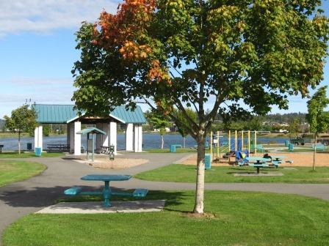
Parks & Recreation

Slide 15
2016 Work Plan
Lake Tye Skate Park Improvements
Fairfield Park Entry Realignment
Public Art Policy & Downtown Art Sculpture
Downtown Events Waiver Policy for City Services
Playground surfacing improvements, ball field safety netting and ball returns

Slide 16
Long Range
Parks and Recreation Element to the Comprehensive Plan
Revising Capital Facilities, including adding synthetic turf fields at Lake Tye
Cadman Master Plan of a public park adjacent to Sky River Park
Upgrades to Lake Tye Park building to enhance use for outdoor performing arts

Slide 17
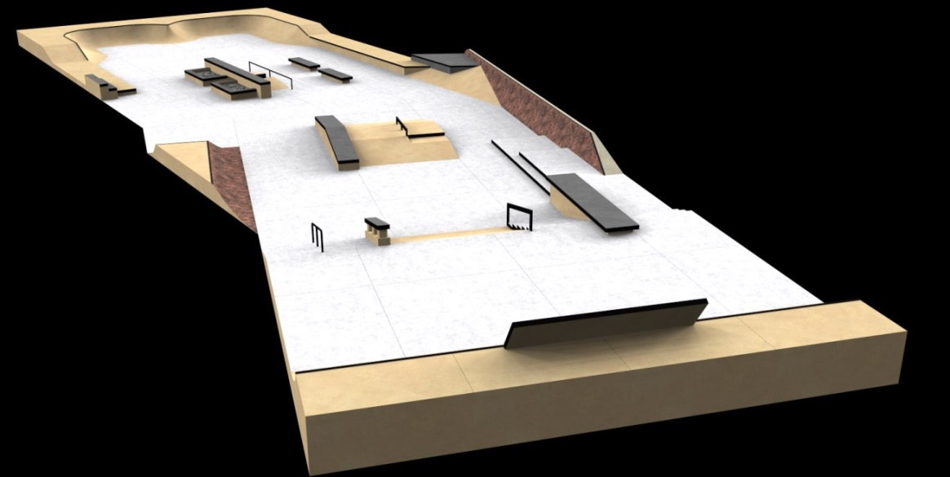
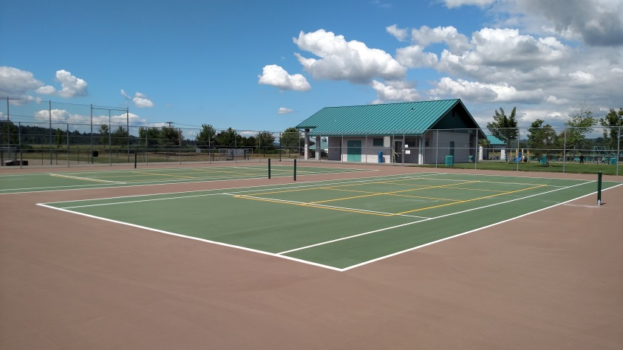
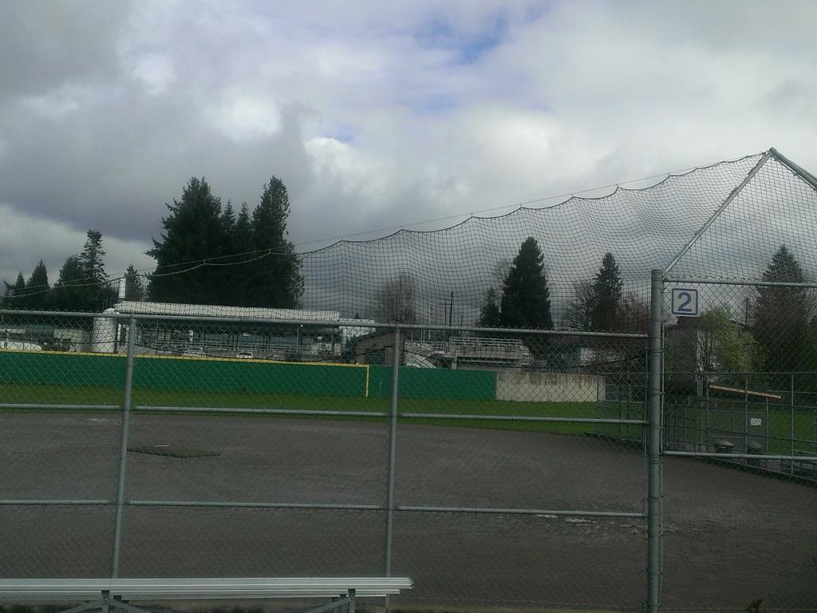
Improvements

Slide 18
Events
There is something fun happening here every week for you to enjoy.
Triathlons
wake board
competitions
dog agility shows
outdoor youth sports camps
sports tournaments
model boat races
fun runs/walks
parade
festivals
2016 Movies at Lake Tye:
  Inside Out
  Pixels
  Jurassic World
  Star Wars: The Force Awakens
2016 Music concerts:
  Longstride Band
  Knutt Bell
  Dana Osborn Band

Slide 19
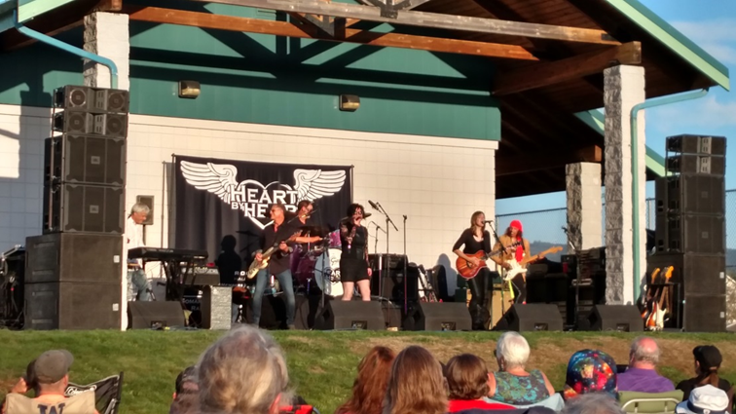
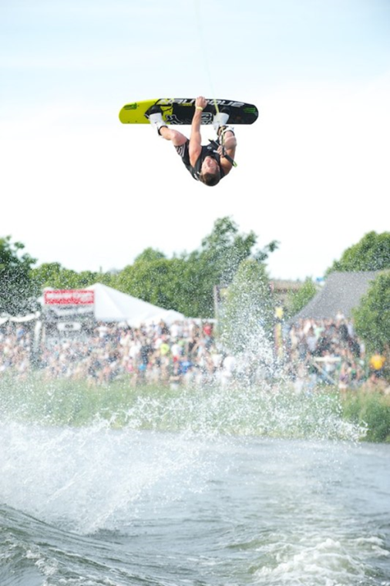
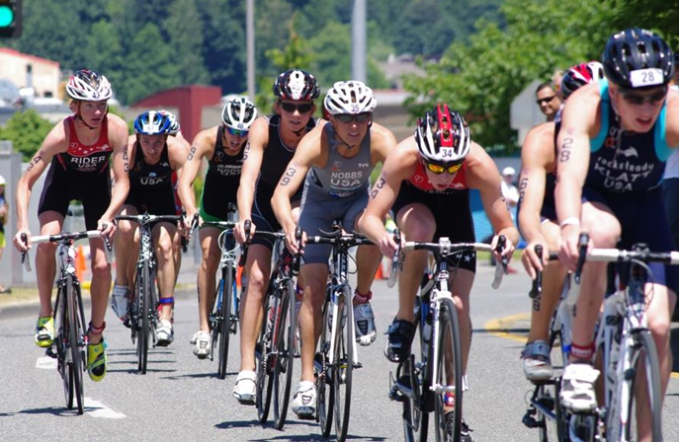
Events

Slide 20
Public Works
PROJECTS
Tjerne Place Extension (Completion 2016)
Sidewalk from The Farm to Tjerne Place along Woods Creek Road
Sidewalk on West Main Street
Sidewalk on 179th Avenue north of West Main
Transportation Benefit District road preservation and rehabilitation

Slide 22
Police Department
Five year strategic plan – Currently meeting with businesses, social services, citizen groups, and the public seeking input.
All commissioned positions are filled with fully trained officers.
Expansion of Social Media – meet us on Facebook, Twitter and Nextdoor.
New World technology went live in October, fully implemented.

Slide 23
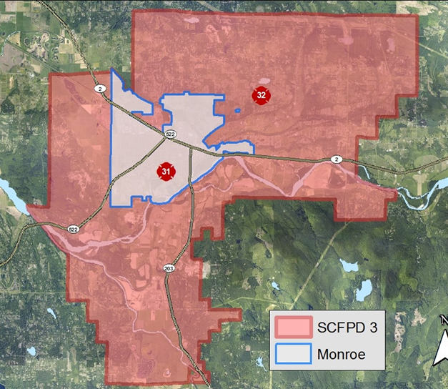
Fire Department
Thank You For Your Support
Fire District 3 provides fire and life safety services to 30,000 residents of Snohomish County Fire District #3 and the City of Monroe
  55 square miles
Responds to an average of 3,400 calls per year
  Approximately 68% are EMS-related
Successful partnership with Fire District 7 already has improved operations for both agencies

Slide 24
Merging with Fire District 7
Partnership is working, but not official yet!
Fire District 3 is planning to ask voters to approve merging with Fire District 7 on August ballot
If approved by voters, the tax rate for property owners in Fire District 3 will decrease
  From projected $2.10 to projected $1.98 per $1,000
    Based on 2016 assessed valuations (AVs)
Property owners in Fire District 7 are not required to vote on the proposal
To contact Fire Chief Jamie Silva call (360) 794-7666 or jsilva@monroefire.org

Slide 25
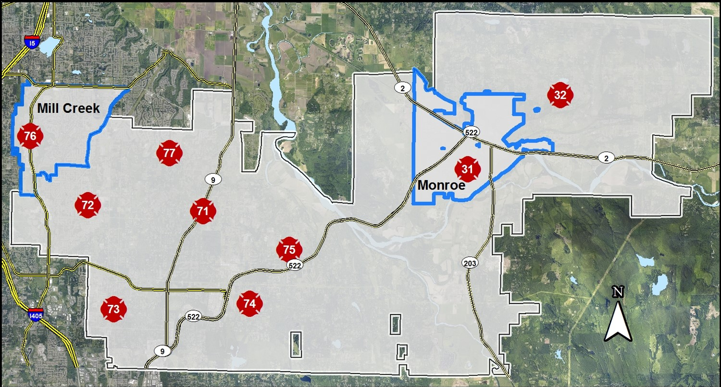

Merged Fire District

Slide 26
Municipal Court
Mission Statement
To contribute to the quality of life in our community by advancing the causes of justice fairly and impartially by efficiently administering justice in a manner that preserves the dignity and rights of defendants as well as the citizens of Monroe.

Slide 27
Court “By The Numbers”
Criminal misdemeanors, gross misdemeanors, traffic infractions, and other City of Monroe Code violations.
Court sessions are on Tuesday mornings and all day Wednesdays; Jury trials are on the 4th Friday.
Since January 1, 2016, the Monroe Municipal Court has filed 850 cases from the Monroe Police Department:
  Traffic Infractions: 723
  Criminal and Non-Criminal: 116
  Parking: 11

Slide 28
Court “By The Numbers” cont.
The court has held 384 first appearance hearings:
  Arraignments: 117
  Infraction hearings: 267
Reviews custody cases to set bail, when appropriate, and conditions of release pending a hearing at Monroe Municipal Court.
Implemented video court for in-custody calendar.
To date, has issued at least 10 pre-trial domestic violence protection orders linked to Assault 4th degree - domestic violence cases.

Slide 29
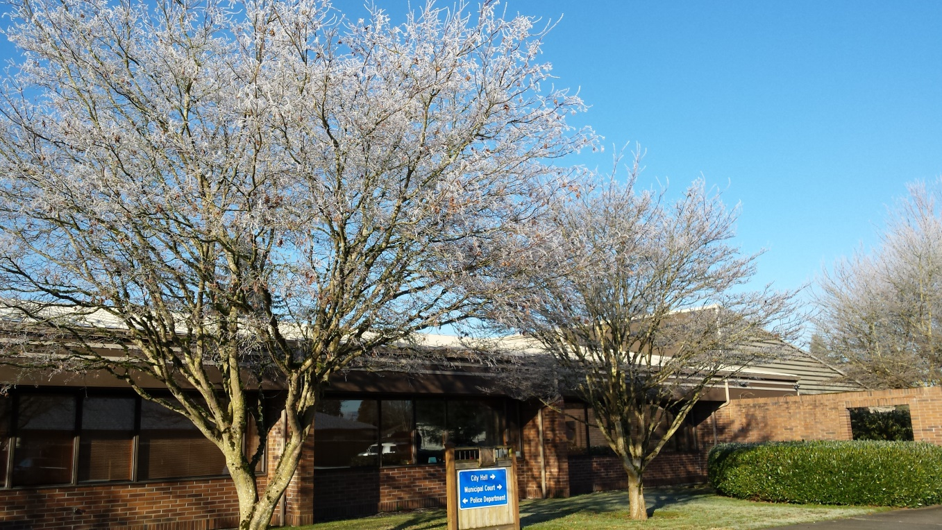
Administration, HR, IT, City Clerk

Slide 30
City Hall
Administration
Monitoring Revenues/Expenditures and annual City budget
Ensure Mayor and Council remain informed & vision is achieved
Selling Land at North Kelsey
HR & IT
Social Media – Facebook, Twitter (coming soon)
Employee Hiring, Support Services, and Policy and Claims management
Labor and Tech Consultant Contracts Management

Slide 31
City Hall
City Clerk
Processed 60+ Public Records Requests to date, per PRA requirements
City records management and retention per state requirements, open public meetings noticing, creation and publication of agenda, minutes, and legislation, and codification of ordinances
Public Defense contract management

Slide 32
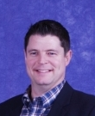

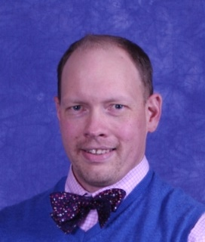
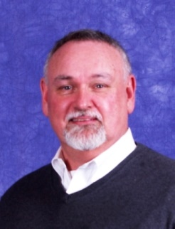
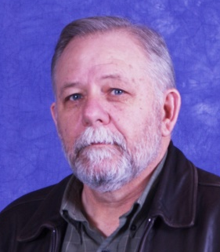
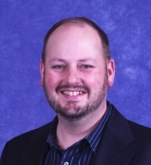
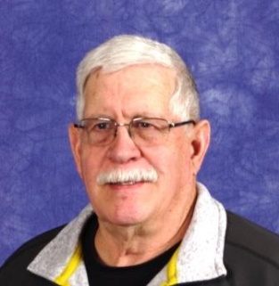
City Council
Kevin
Hanford
Position 1
Patsy Cudaback
Position 2
Jeff
Rasmussen
Position 3
Jim Kamp
Position 4
Ed Davis
Position 5
Jason
Gamble
Position 6
Kirk
Scarboro
Position 7
Contact: councilmembers@monroewa.gov

Slide 33
City of Monroe Involvement with Committees/Organizations
Snohomish Health Board (CM Rasmussen)
Community Transit Board Alternate
(CM Cudaback)
Snohomish County Tomorrow (CM Kamp)
French Slough Flood Control District
(CM Kamp)

Slide 34
City of Monroe Involvement with Committees/Organizations
Economic Alliance of Snohomish County
Snohomish County Committee for Improved Transportation
Snohomish County Cities
PSRC Economic Development District

Slide 35
City of Monroe along with our community has actively advocated in Olympia for:
Synthetic Turf for Lake Tye Fields
SR-522 Widening (Supported by over 65 businesses, non-profits, and other agencies)
191st St. Connection

Slide 36
Mayor
Meeting Chamber Board for lunch monthly
Meeting with Councilmembers and Residents
Representing and promoting Monroe at Regional and State Meetings
Working closely with city staff
Working with non-profits, agencies, and for-profits groups
Weekly newsletter “Monroe This Week”
Social Media - Facebook

Slide 37
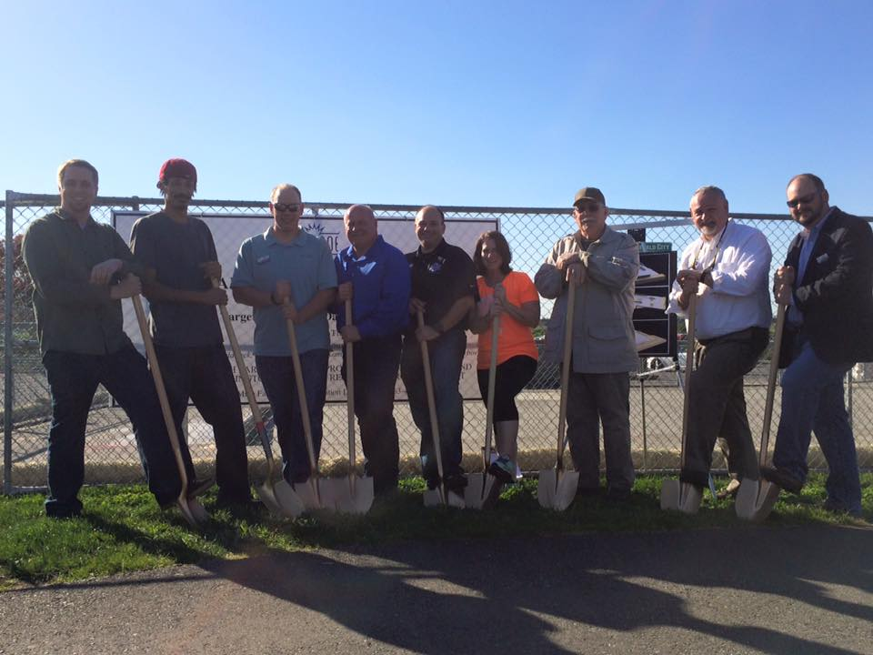
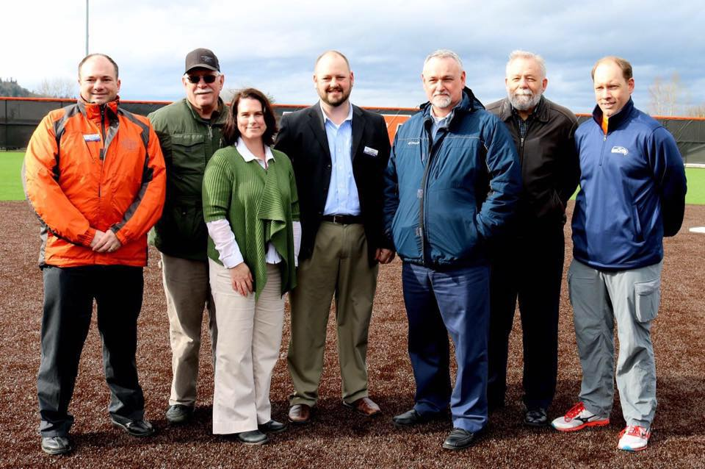
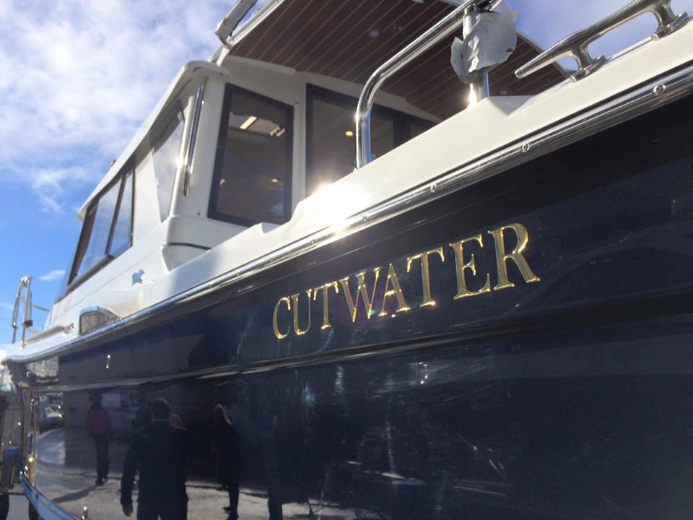

Slide 38
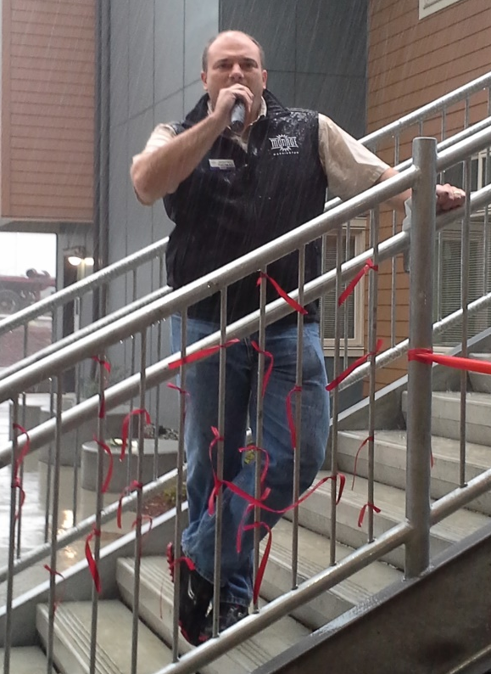
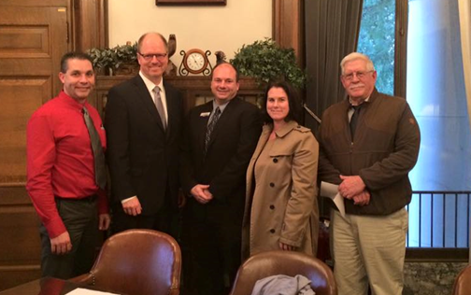
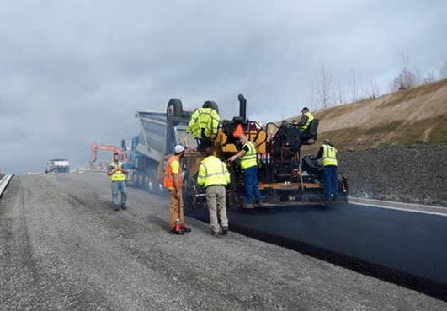

Slide 39
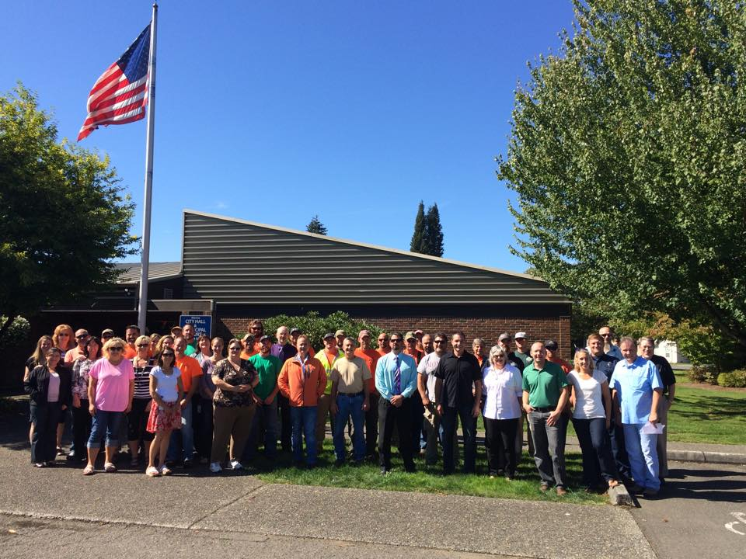
City Hall
806 W. Main St.
Monroe, WA 98272
360-794-7400
www.facebook.com/monroewagov

Slide 40
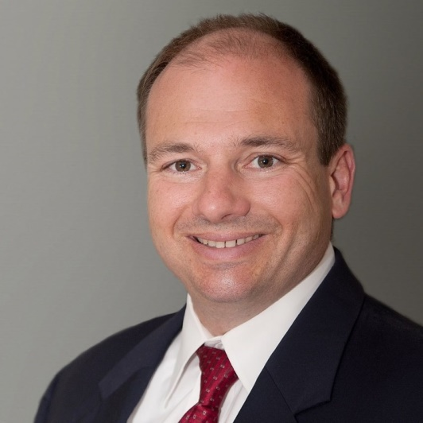
QUESTIONS??
Contact Information:
Mayor Geoffrey Thomas
gthomas@monroewa.gov
www.facebook.com/mayorthomas360
360-926-6718 (Voice Only)

