Slide 1

CITY OF MONROE
Mayor Geoffrey Thomas
Hidden River Middle School
Career Day
April 7, 2016

Slide 2


City of Monroe Citizens
Population 17,800+
Judge
Mayor
City Council
Court
City Administrator
Chief of Police
Public Works
Parks
Finance
Community
Development
Human Resources
City Clerk
I.T.
Emergency Management
Wastewater
Treatment
Building
Planning
Operations & Maintenance
Design & Construction

Slide 3
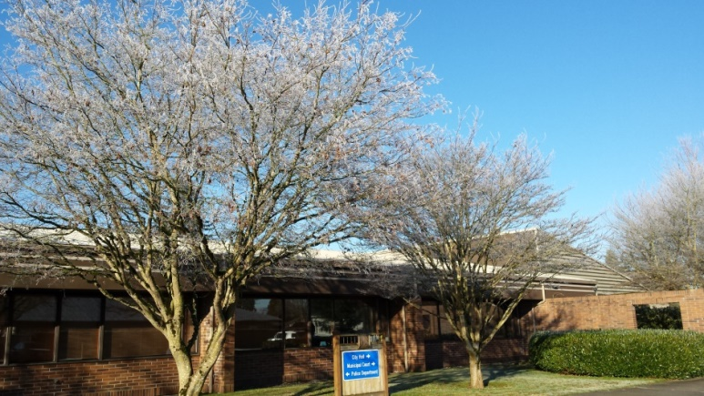

CITY OF MONROE DEPARTMENTS
Community Development
Finance
Human Resources
Municipal Court
Parks and Recreation
Police
Public Works

Slide 4
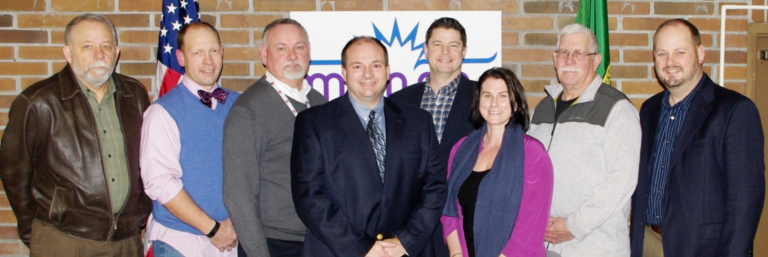

City of Monroe City Council
The City of Monroe has a strong Mayor/Council form of government. The mayor is elected by the citizens and serves a four-year term as the chief executive officer (CEO) responsible for managing the city. The Mayor in a strong-mayor form of government does not vote on matters brought to the City Council.

Slide 5


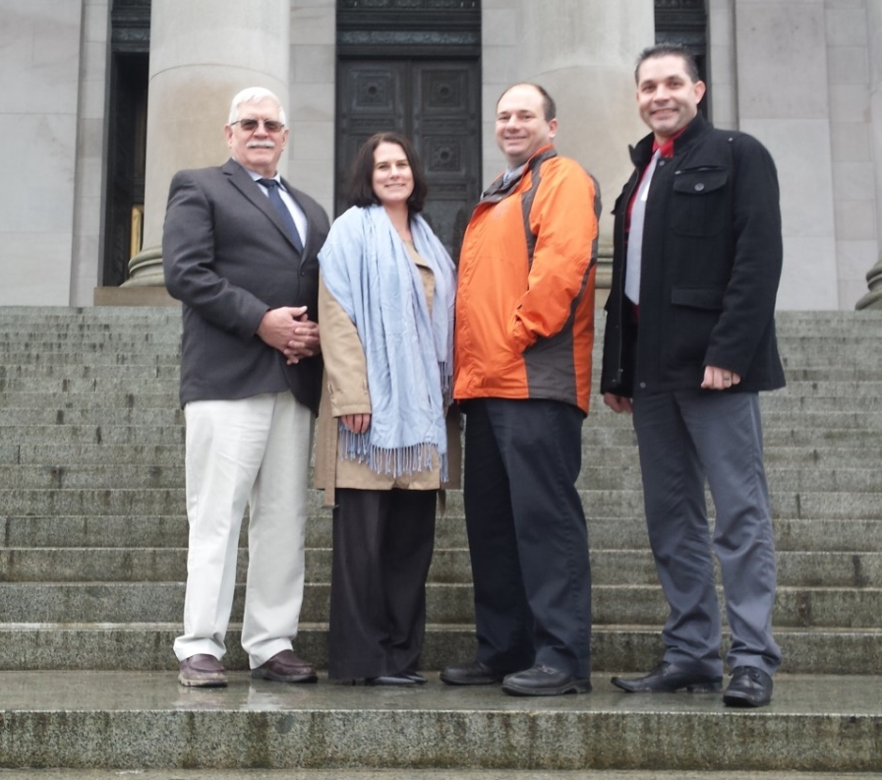
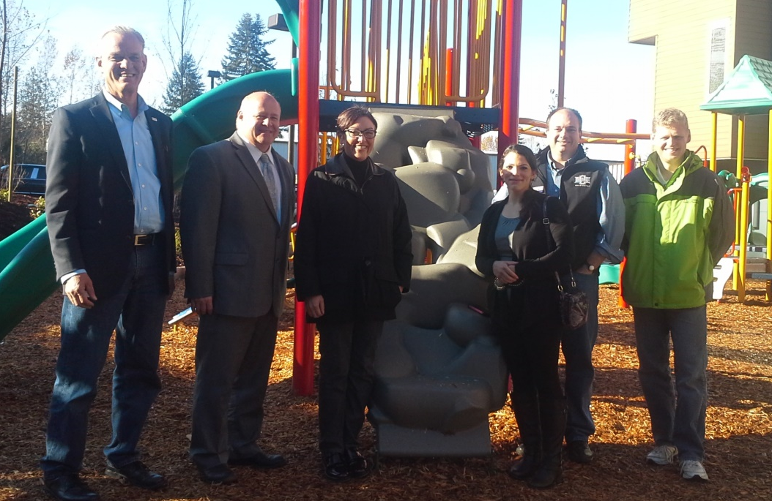

Events Attended!

Slide 6


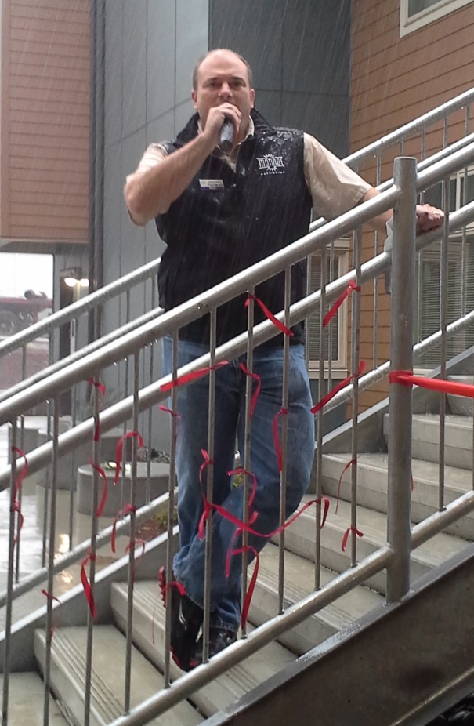



Slide 7
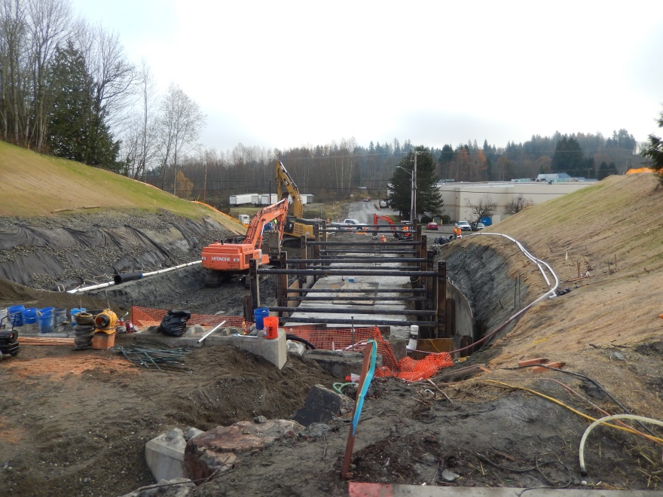
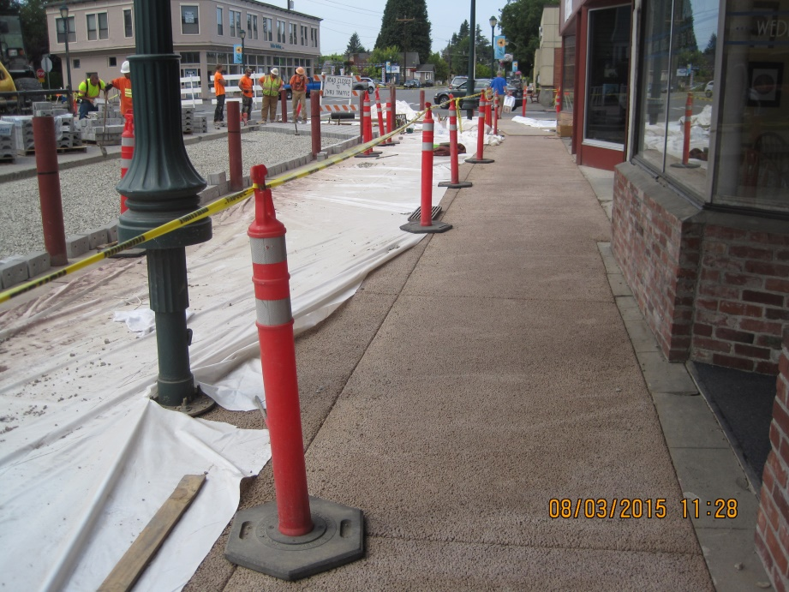
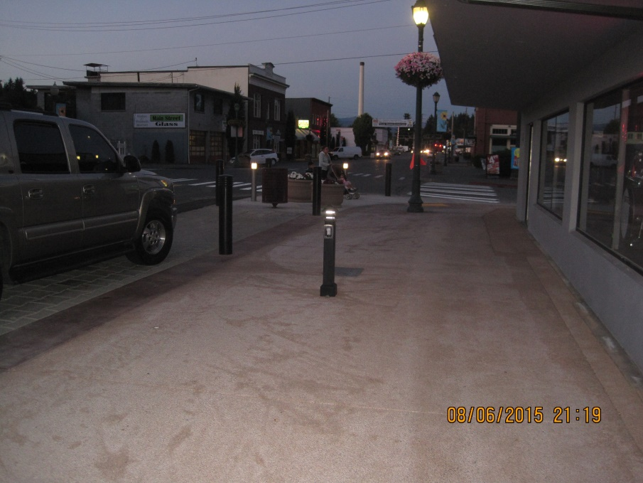
PROJECTS

